Slide 1
ANCIENT GREEKS – YOUNG HEROES LESSON 2

Slide 2
The Ancient Greeks… and their dogs
In welke goden geloofden de oude Grieken?
Dogs: friends or monsters?
Trip to the underworld
Body parts

Slide 3
Recap
Alphabet

Slide 4
A few words: ancient and new
κινημα δελφις
βαρβαρος κυων
βιβλιον κεφαλη
χαος Ταρταρος

Slide 5
Dogs, Kerberos (Cerberus) and other dog monsters

Slide 6
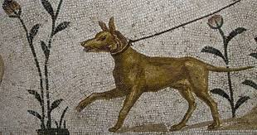
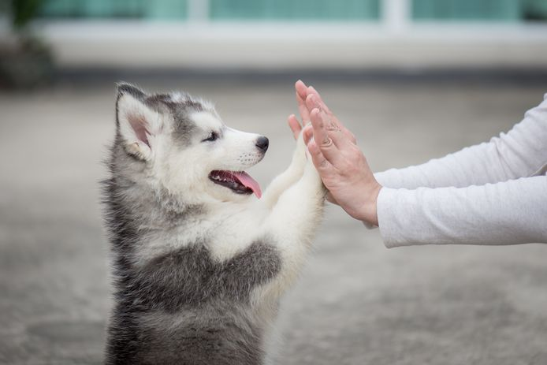
Ancient Greeks and their dogs

Slide 7
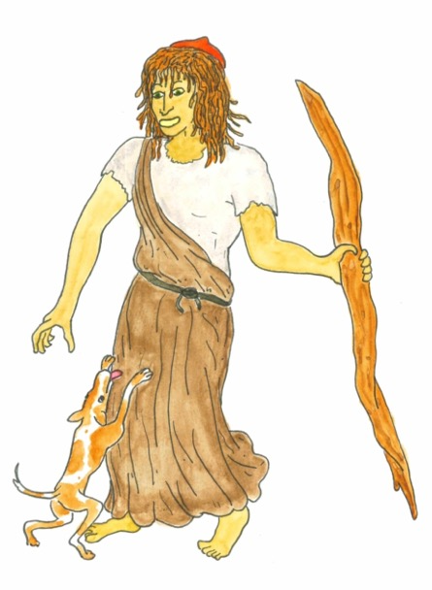
Odysseus and Argos
Ἀργος is the mighty dog of Odysseus.
He was trained by Ὀδυσσευς for hunting and was superior to all the other dogs.
Once Ἀργος picked up a trail, no animal escaped his sharp jaws.
But when Ἀργος was an adult, Ὀδυσσευς
left for the war.
He left his dog behind.
Notes:
Fragment uit Ilios en Odysseus van Imme Dros 355-356

Slide 8
Odysseus and Argos
After this, nobody looked after Ἀργον.
He had to fend for himself.
That is how Ἀργος drifted around the island for 20 years. He became an old dog, covered in lice.
Often, he would nap in a pile of dung
near the house of Ὀδυσσευς.
Notes:
Fragment uit Ilios en Odysseus van Imme Dros 355-356

Slide 9
Odysseus and Argos
One day, Ἀργος spotted his master Odysseus among a group of people.
Ἀργος started wagging his tail with joy, tucked his ears back and wanted to dash towards Odysseus.
But his worn-out body could no longer
cope with the excitement. His heart
gave up and eventually stopped beating.
Notes:
Fragment uit Ilios en Odysseus van Imme Dros 355-356

Slide 10
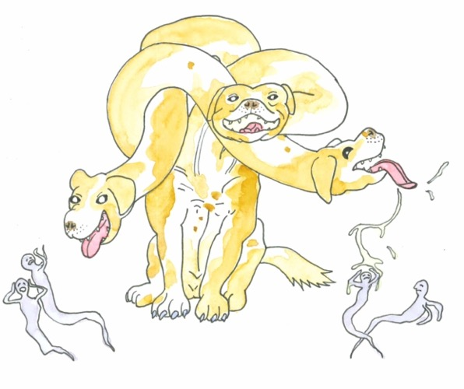
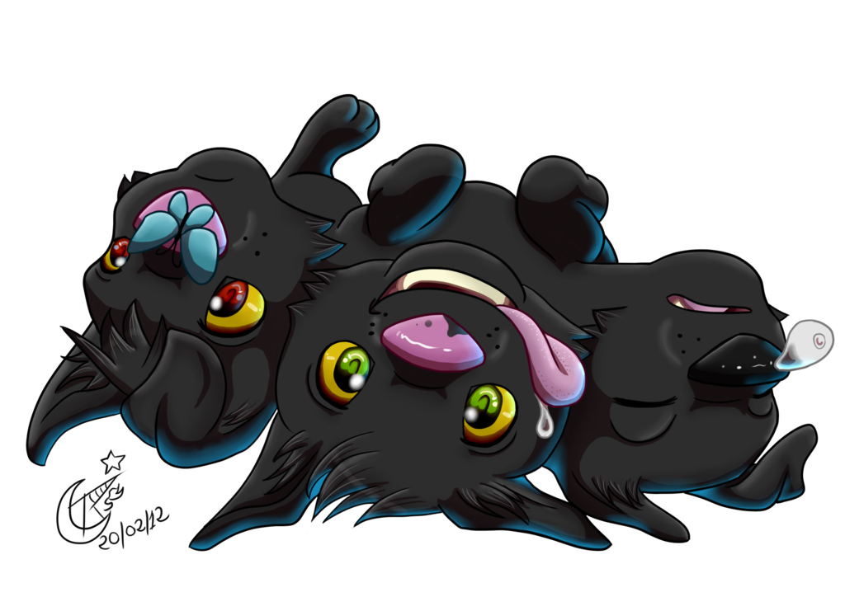
Monster dogs: Κερβερος
Notes:
Van links naar rechts: vaas – puppy - in film Hercules

Slide 11
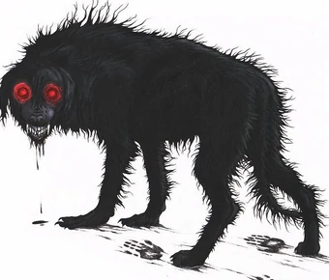
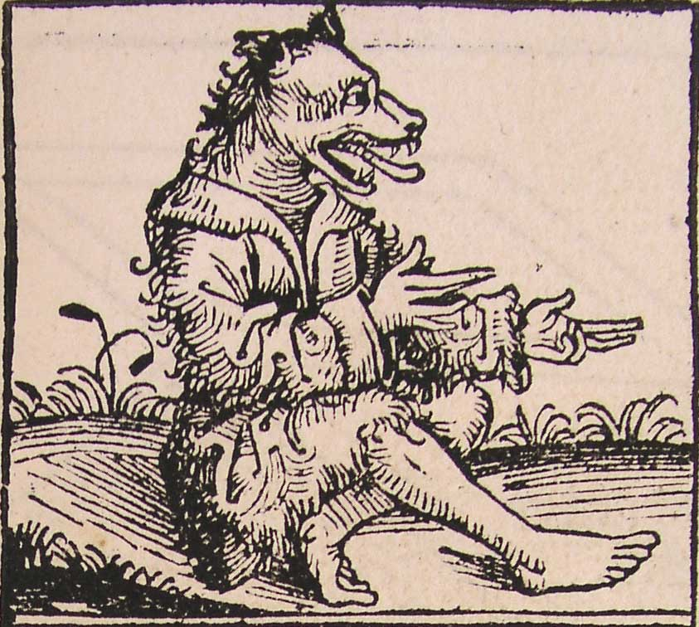
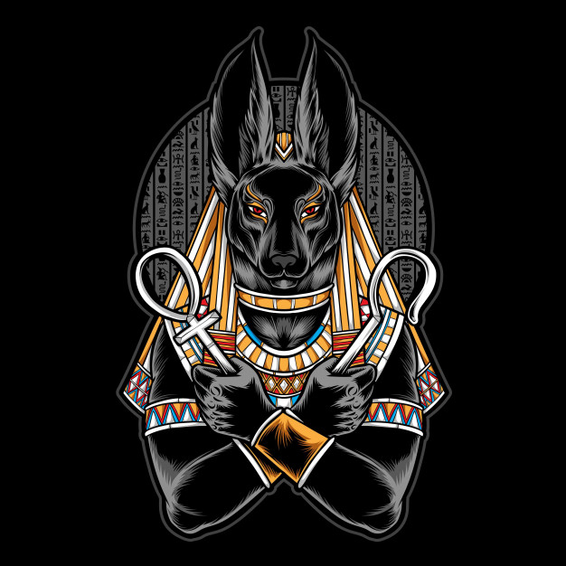
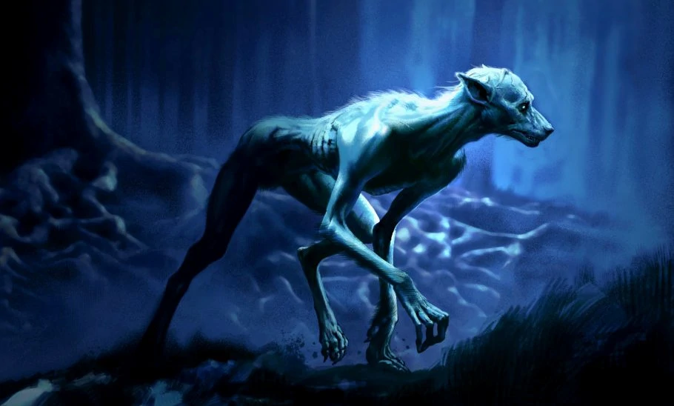
Other monster dogs
Notes:
Van links naar rechts: Anubis – Okuri-Inu – weerwolf in Harry Potter – Cynocefalen (Herodotos)
Wat maakt een monster tot monster?

Slide 12
Game: The Underworld
Green: You are a hero, travelling to the underworld. Good luck getting in safely!
Orange: You are Cerberus.
Try to be a good guardian!

Slide 13
To the Underworld
You are a παιδιον and heading for the underworld. What will you take?
Green: A backpack with a book, coins and a lollipop.
Orange: I’m not taking anything. The trip will be hard enough without luggage.

Slide 14
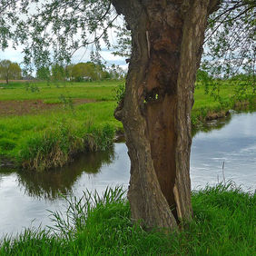
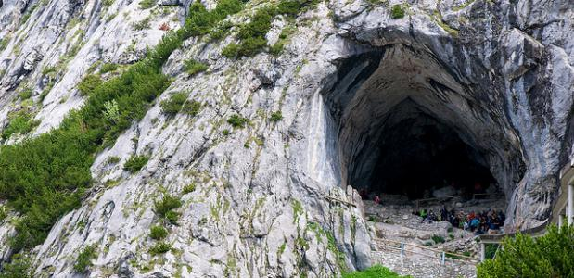
To the Underworld
You are looking for the entrance to the underworld. On the left you see a cave, on the right you see a hollow δενδρον. Which way do you choose?
Green: Left, the cave.
Orange: Right, the hollow δενδρον.

Slide 15
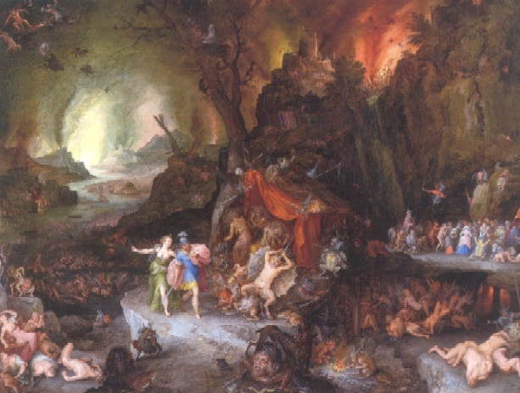
To the Underworld
You have arrived in the underworld, but you still have to face dangers before getting past the guards …

Slide 16
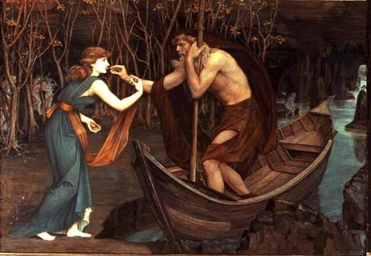
To the Underworld
At the river Styx, the ferryman Χαρων enquires: “Did you bring coins to pay for the crossing?”
Green: No, because I didn’t
bring anything.
Orange: Yes, they’re in my
backpack.

Slide 17
To the Underworld
Oops, that's not the way to enter the underworld safely…
Go back

Slide 18
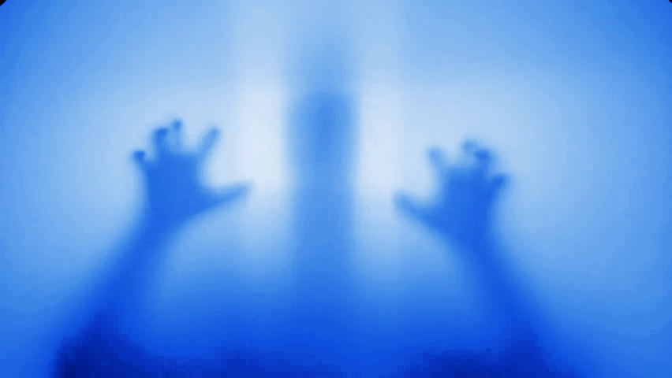
Naar de onderwereld
Χαρων took you across the Styx, but now the ψυχη of a dead person is coming at you! What do you do to chase away the ψυχην?
Green: I pick up a stick to scare the ψυχην off!
Orange: I sing a dreadful song as out of tune as possible!

Slide 19
To the Underworld
Oops, that's not the way to enter the underworld safely…
Go back

Slide 20
To the Underworld
You chased away the ψυχην. You have no idea where to go next. What do you do?
Green: I consult the βιβλιον in my backpack.
Orange: I’m already fed up with the trip, so I suck my lollipop.

Slide 21
To the Underworld
Oops, that's not the way to enter the underworld safely…
Go back

Slide 22
To the Underworld
On the map in your βιβλιον, you notice that you have to pass Κερβερον.
Κερβερος is the three-headed dog that guards the underworld. What do you do?
Green: I’m scared, but go on anyway.
Orange: I like dogs, so no problem!

Slide 23
To the Underworld
Κερβερος gives a loud roar. He won't let you pass without a fight. How do you solve this?
Green: You chuck your lollipop into one of its three jaws.
Orange: You try to stroke one of its three heads.

Slide 24
To the Underworld
Oops, that's not the way to enter the underworld safely…
Go back

Slide 25
To the Underworld
Κερβερος is distracted. What do you do to ensure that he does not follow you?
Green: I push Κερβερον aside with a stick.
Orange: I sing a lullaby.

Slide 26
To the Underworld
Oops, that's not the way to enter the underworld safely…
Go back

Slide 27
To the Underworld
This is the τελος.
Congratulations, you have safely entered the underworld!
Again!
Time for a change!
τελος

Slide 28
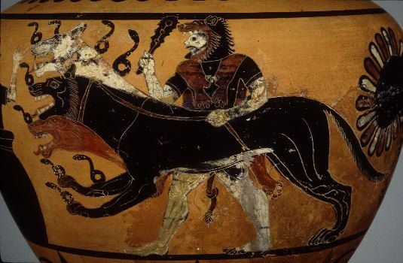
In the Underworld
You see a savage hero rushing towards you. He is heading for the underworld and carries the skin of a λεων on his shoulder. What do you do?
Green: I pretend I am not
afraid, but let him
pass.
Orange: I attack him!

Slide 29
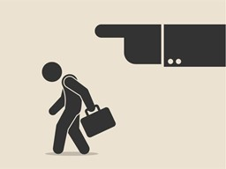
In the Underworld
Oops, you didn't do your job properly. You’re fired!
Turn back

Slide 30
In the Underworld
You are quietly keeping watch at the entrance to the underworld, when suddenly you hear a γυνη screaming. What do you do?
Green: I leave my watch post. The γυνη needs my help!
Orange: I stay put. There are lots of people screaming here.

Slide 31
In the Underworld
Oops, you didn't do your job properly. You’re fired!
Turn back

Slide 32
In the Underworld
A παιδιον heads towards you and feeds you honey biscuits. How do you react?
Green: I, Κερβερος, am simply too smart for that! Those biscuits can wait. I swallow the παιδιον whole!
Orange: Honey biscuits, my favourite! I finish them off while the παιδιον slips inside.

Slide 33
In the Underworld
Oops, you didn't do your job properly. You’re fired!
Turn back

Slide 34
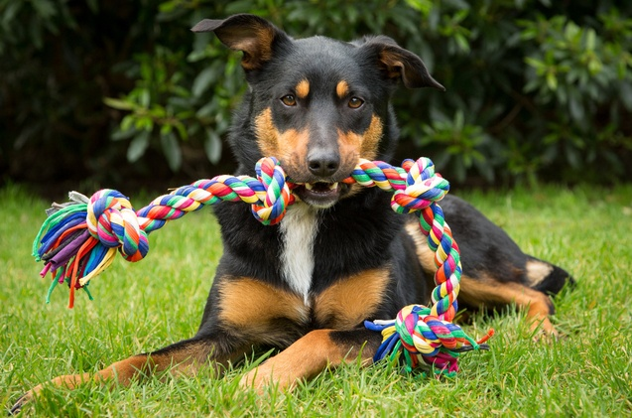
In the Underworld
Ἀριαδνη wants you to play and chase the rope.
Green: I'm a guard dog, I don't play!
Orange: Ooh, it's been such a long time since anyone played with me. I run after
Ἀριαδνην!

Slide 35
In the Underworld
Oops, you didn't do your job properly. You’re fired!
Turn back

Slide 36
In the Underworld
The Μινωταυρος comes running at you. He wants to know which of you is the most dangerous and toughest monster.
Green: I know I am the most dangerous. I have three times as many teeth! I challenge the Μινωταυρον to a duel.
Orange: I fear the Μινωταυρον, because he’s bigger and stronger. I tell him that he is the toughest monster.

Slide 37
In the Underworld
Oops, misjudged it... The Μινωταυρος tears your three heads off.
Turn back

Slide 38
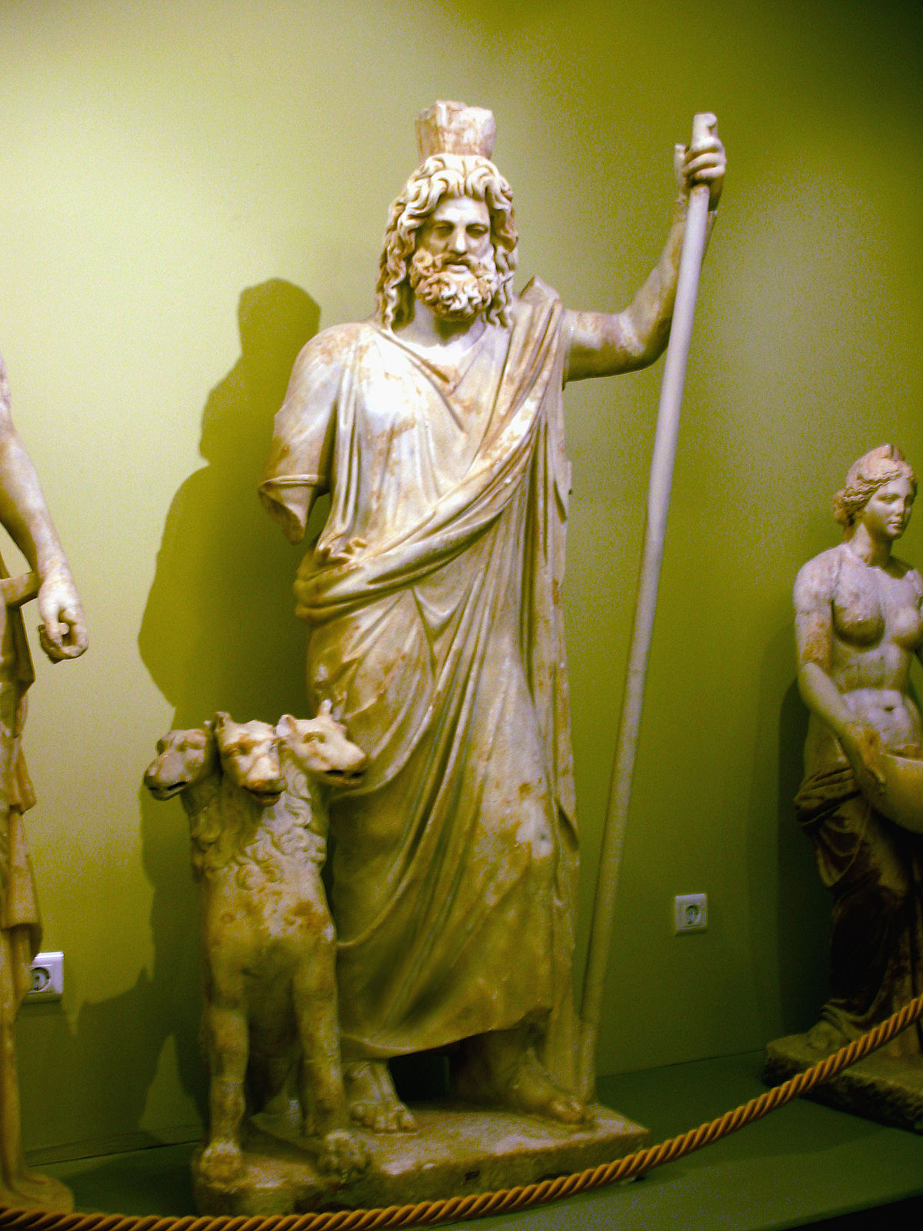
In the Underworld
Ἁιδης, the god of the underworld and your master, is calling you. He wants to send Κερβερον to dog school.
Green: I'll prove that's not necessary.
I'm too tough for that.
Orange: I’m on my way! This is the best chance to fight with all the dogs at the school!

Slide 39
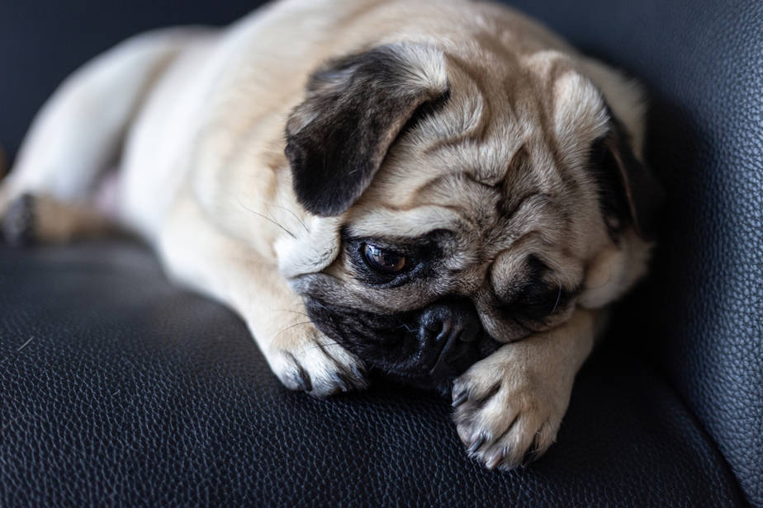
In the Underworld
The dog school is a boarding school. You have to leave the underworld. You’re not such a good guard dog, after all.
Turn back

Slide 40
In the Underworld
A ψυχη from the underworld approaches you. She wants to go back to her family.
Green: I bite the ψυχην in her leg and drag her back! It's my job to keep all the souls here!
Orange: I weep for pity and pretend I didn't see the ψυχην. A tough dog can have a moment of weakness too...

Slide 41
In the Underworld
Oops, you didn't do your job properly. You’re fired!
Turn back

Slide 42
In the Underworld
A gigantic γιγας is heading towards you. He wants to go back up to take revenge on the man who blinded him.
Green: I let him pass, because he can just crush me.
Orange: I see that he is blind and bite him in three different places at the same time!

Slide 43
In the Underworld
Oops, you didn't do your job properly. You’re fired!
Turn back

Slide 44
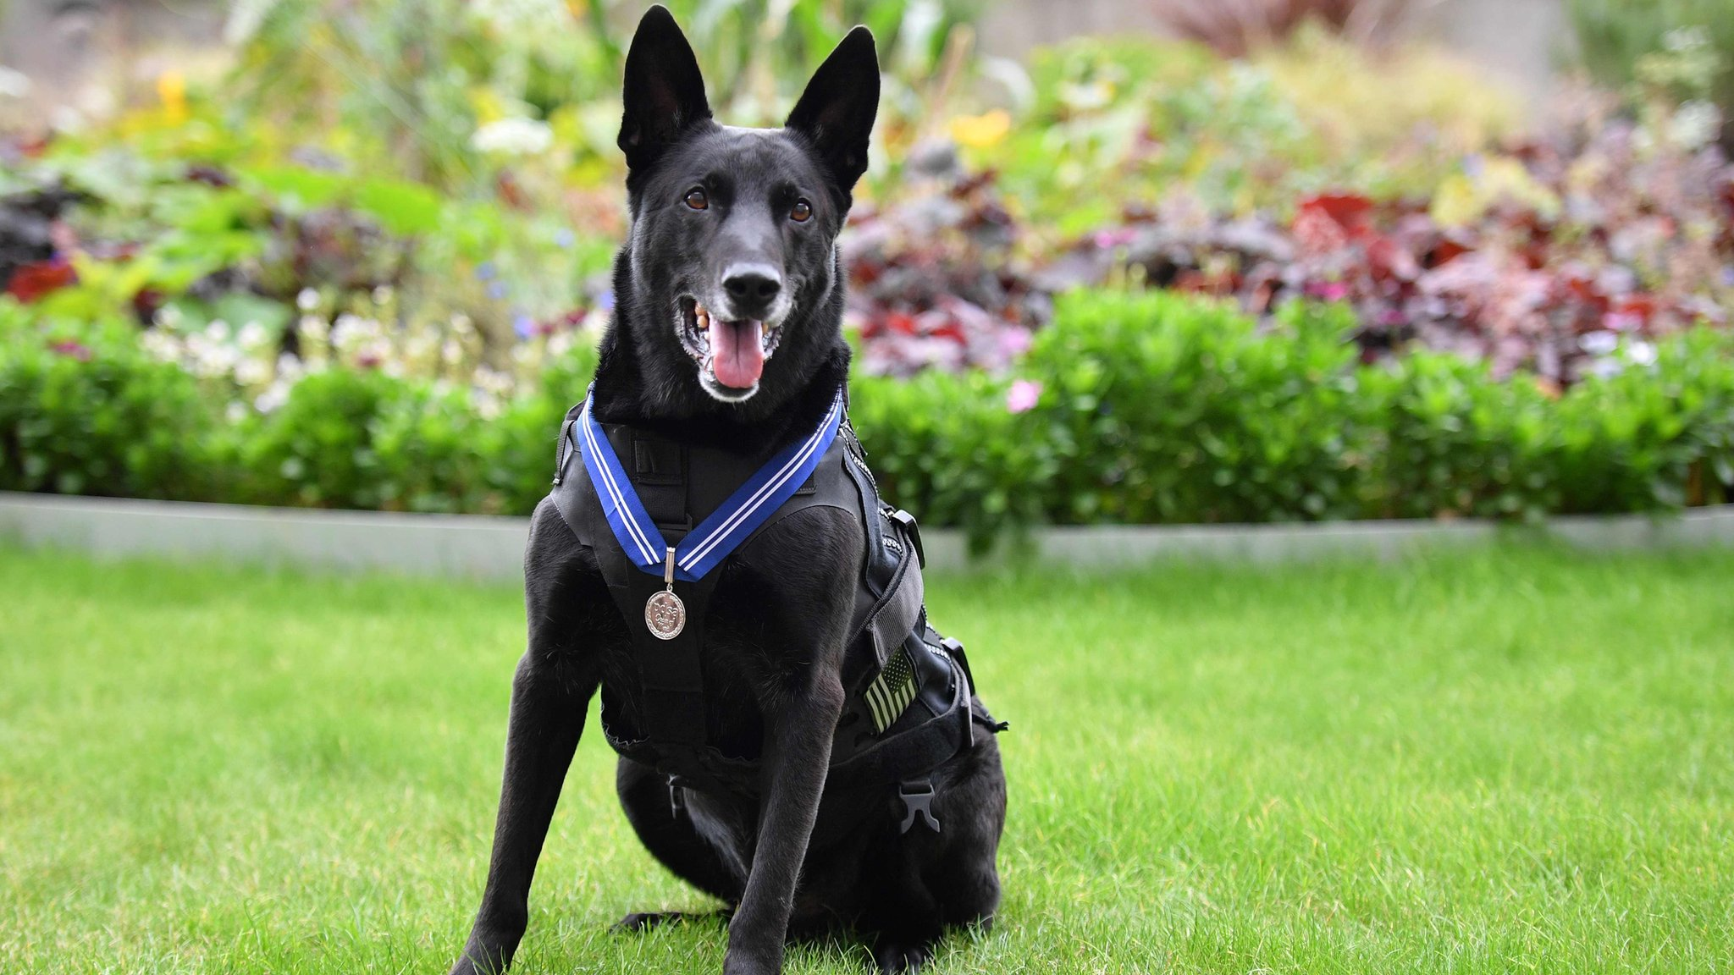
In the Underworld
Congratulations, you have defeated all intruders. You are an excellent guard dog!
Again!
Time for a change!

Slide 45
Make your own monster

Slide 46
Draw and describe your monster,
using these words:
κεφαλη (head) θριξ (hair)
στηθος (chest) ὀφθαλμος (eye)
γονυ (knee) στομα (mouth)
πους (foot) χειρ (hand)

Slide 47
Subject Direct Object

Slide 48
Subject
Κερβερος is roaring loadly.
A ψυχη from the underworld is coming near.
You are a παιδιον and are going to the underworld.
→ Who/what is doing the action?
Notes:
Deze dia moet nog aangepast worden

Slide 49
Direct Object
You see that you have to pass Κερβερον.
You have chased away the ψυχην.
I swallow the παιδιον whole!
→ Who/what is undergoing the action?
Notes:
Deze dia moet nog aangepast worden

Slide 50
What is the role of the word in the sentence?
Subject | Direct Object
Κερβερος | Κερβερον
ψυχη | ψυχην
παιδιον | παιδιον

Slide 51
What will you remember from this lesson?

